Slide 1
Spring 2016 Leadership Conference -
Style Exercise Share Out
March 2016

Slide 2
Your Task
‹#›

Slide 3
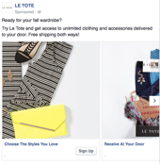
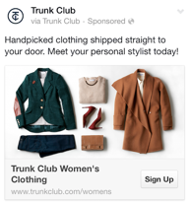
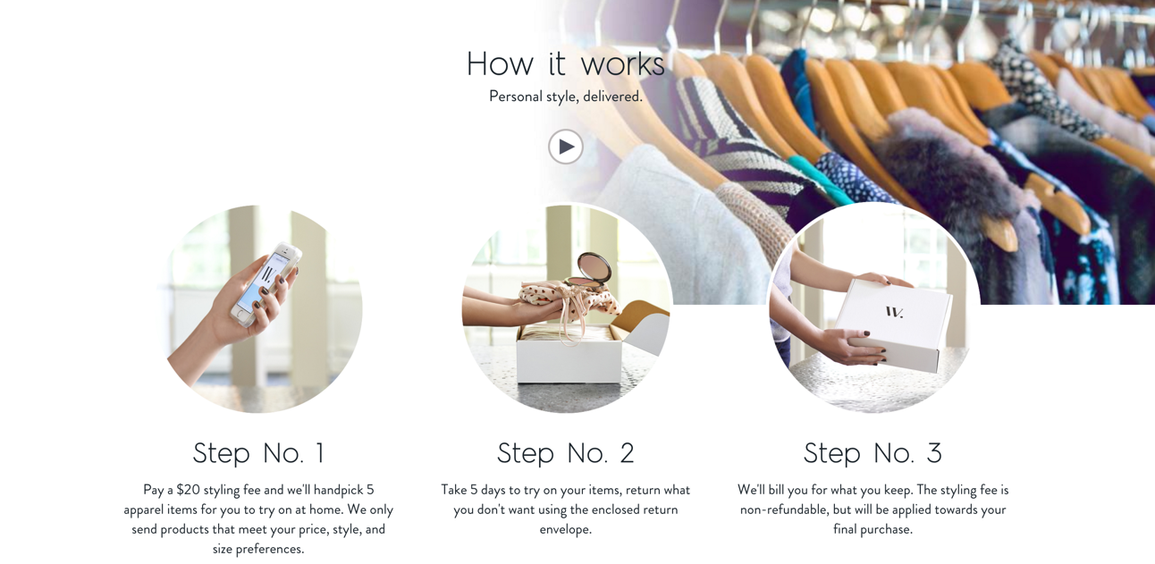
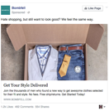
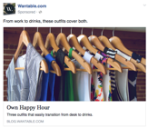
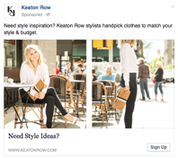
What’s happening “out there”...
Competitors:
More and more “me too” business models are popping up, and they are “Shamelessly Stealing” our historical external look, feel and messaging.
Our challenge:
How can we evolve and grow so that Stitch Fix shows up as a differentiated, superior brand that speaks to a wide range of women?

Slide 4
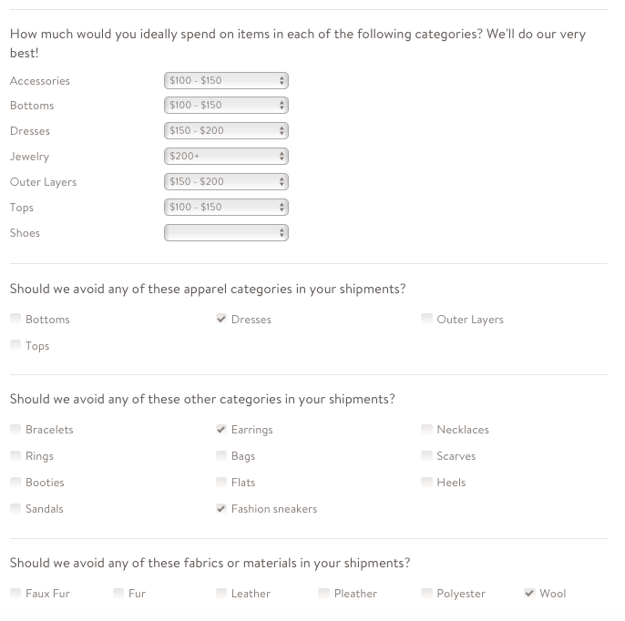
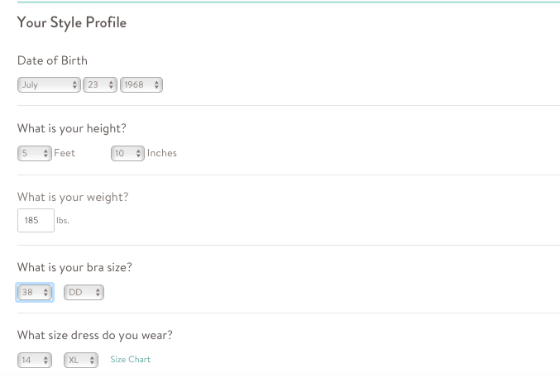
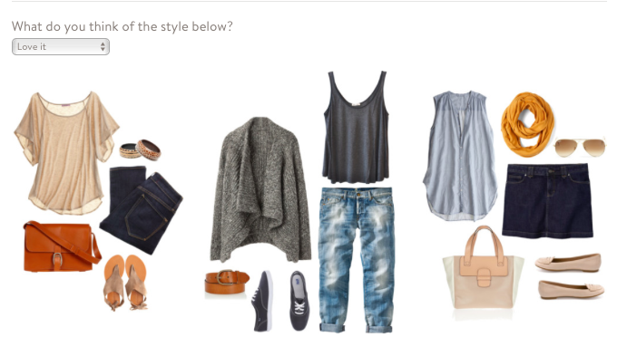
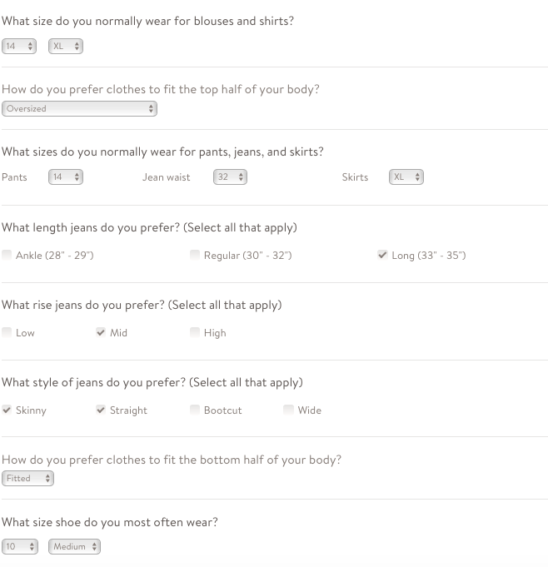
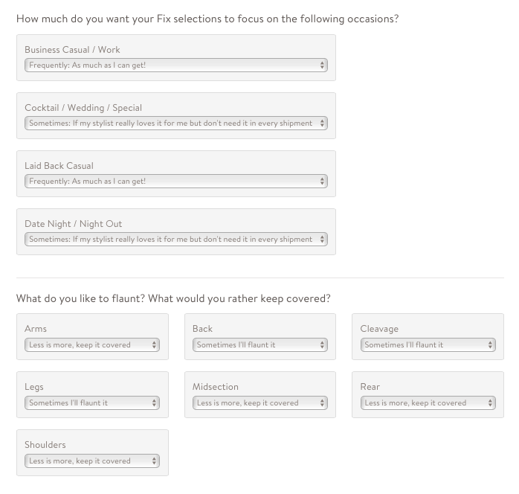
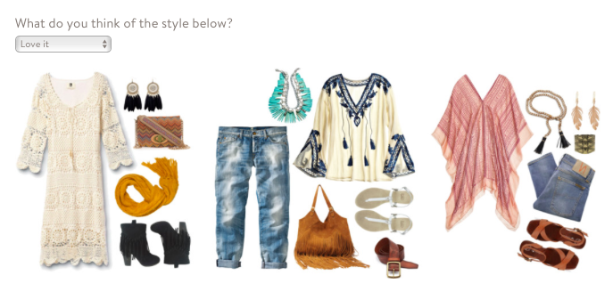
Challenge: Style Profile

Slide 5
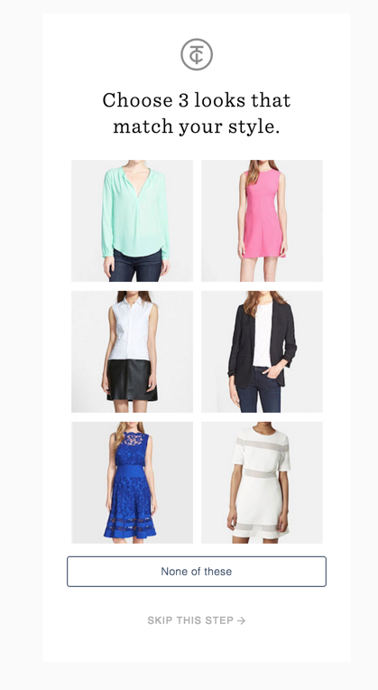
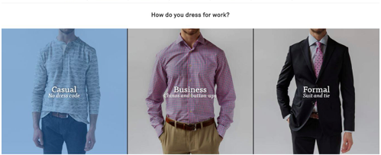
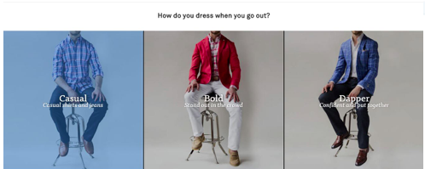
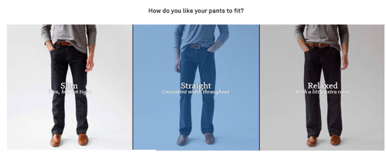
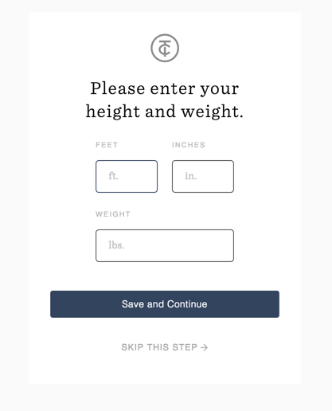
Your task?
As a group, think of new ways to approach getting to know and understand our client’s style.

Slide 6
Team 1
Jessica Harkey
Jenny Lindemann
Talleda Rasheed
Sara Duncan
Julie Kral
Nicole Gordon
Kristen Walsh
Megan Mork
‹#›

Slide 7
Initial Brainstorm
Basic profile info
Get an idea of a client’s likes based on more than just clothing
Ask about specific brands that they shop/like (offer options and “other”)
Work uniform – traditional, relaxed, artistic (with pictures)
Highlight specific pieces versus outfits – turn into internal Pinterest board
More pictures regarding fit/more options shown (e.g., where do you want your top fitted) – separate pictures for fit
Clarify dream closet versus reality (do you like something because of style or fit?)
Use mood boards with home/scenery/patterns/spaces to get a better idea of lifestyle aspiration aesthetic
Seasonal profile update reminders with looks within that season
Using purchase history to send emails with outfit suggestions
Trends versus categories
Color palettes – selecting options
Fashion plates online – choose favorite tops/bottoms/shoes separately
Strong “Nos”
Use guiding questions to trigger specific mood boards and questions
What best represents you with lifestyle images (e.g., yoga, brunch, date night, park with kids)

Slide 8
Bringing it to Life
Basic Profile Information
Lifestyle images – different life scenarios
Exercise
Dining out
Travel
Concerts
Park
Home - reading/tv
Work environments
Classroom
Boardroom
Home
Retail
Doctor’s office
Cooking dinner
Mood board
Pattern
Texture
Scenery
Color palettes
Spaces
What brands do you like/shop?
Specific pieces/outfit pictures (Fashion Plates online) (likes and avoids/strong no)
Chosen images automatically create internal Pinterest board for stylists only

Slide 9

Examples

Slide 10
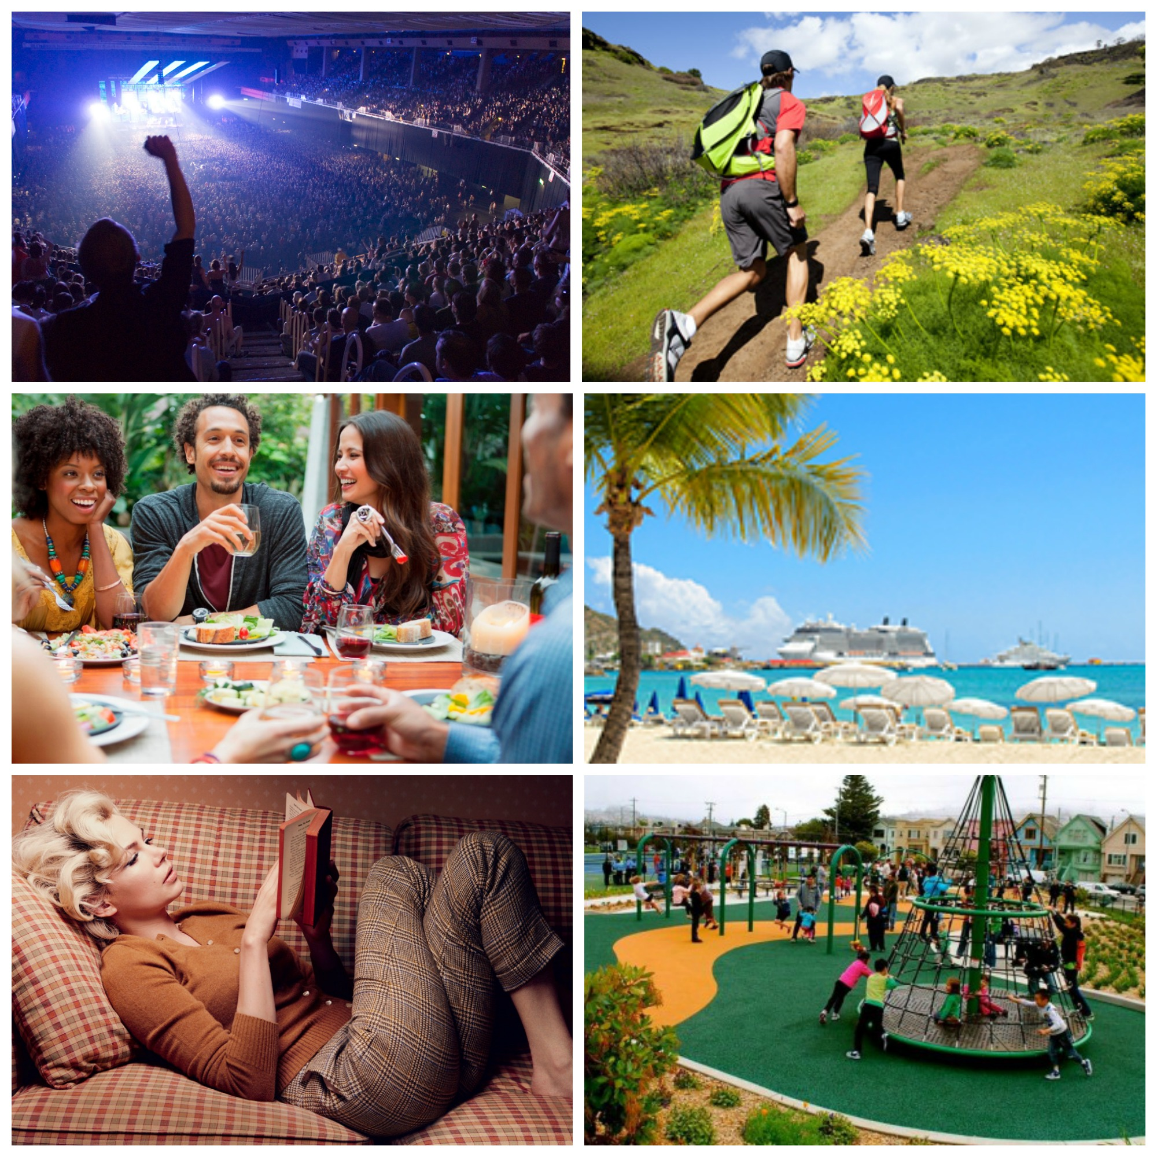
2. Lifestyle Images
Choose images that represent your life

Slide 11

3. Work Environment
Choose a picture(s) that best describes your work environment

Slide 12
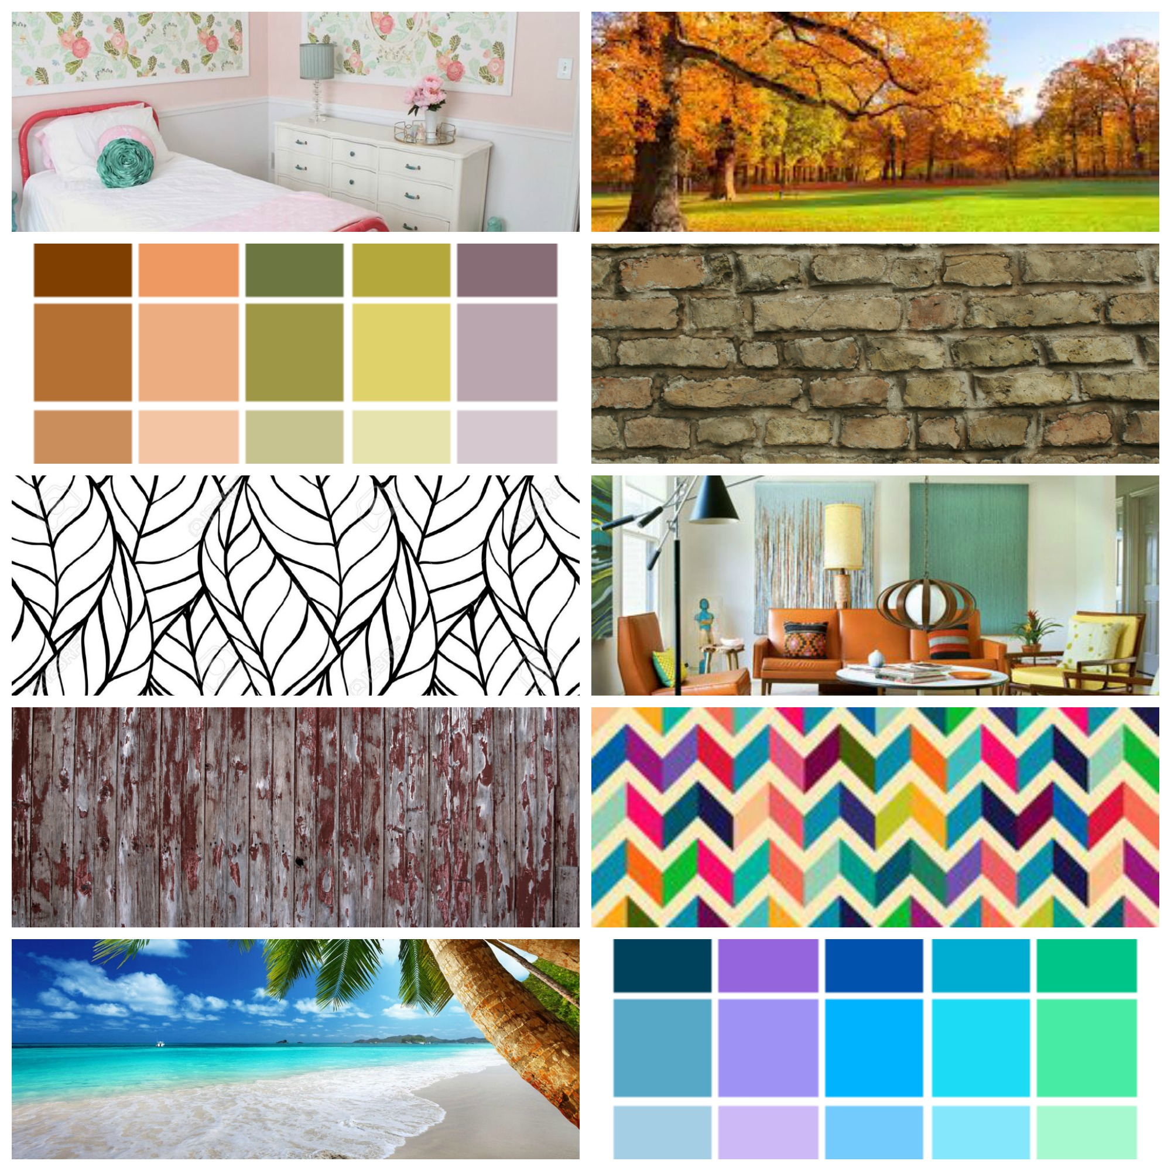
4. Mood Board
Choose a picture(s) that resonates with you

Slide 13
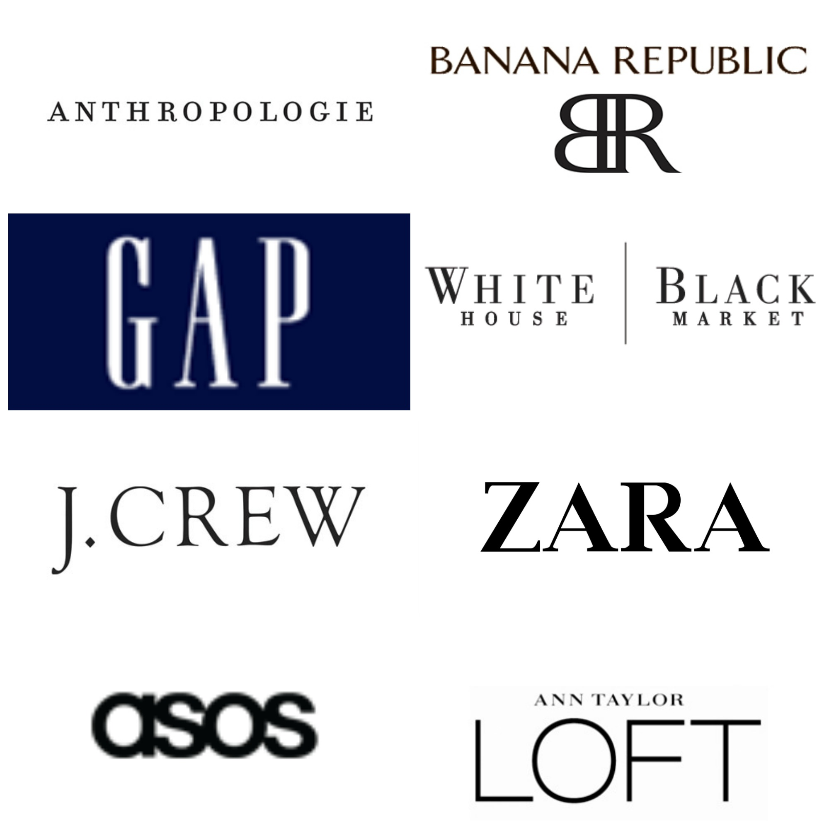
5. Brands
Choose what brands you shop and/or like

Slide 14
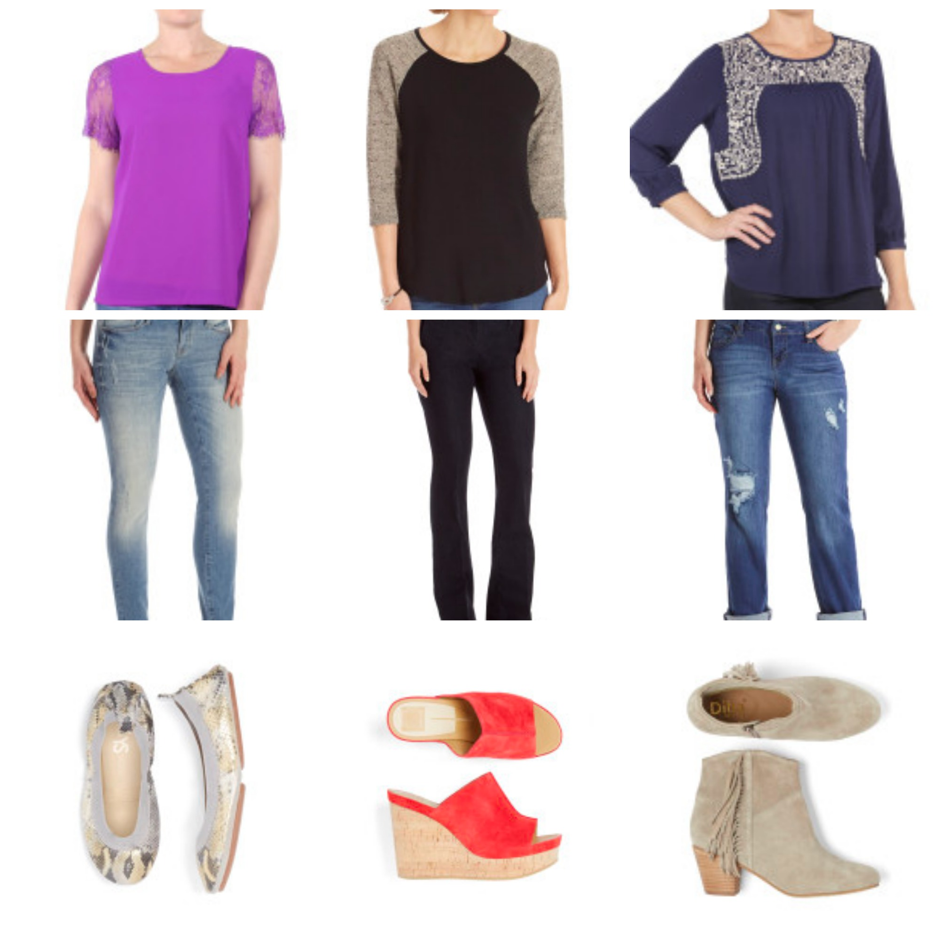
6. Specific Pieces
Choose item(s) that resonate with you

Slide 15
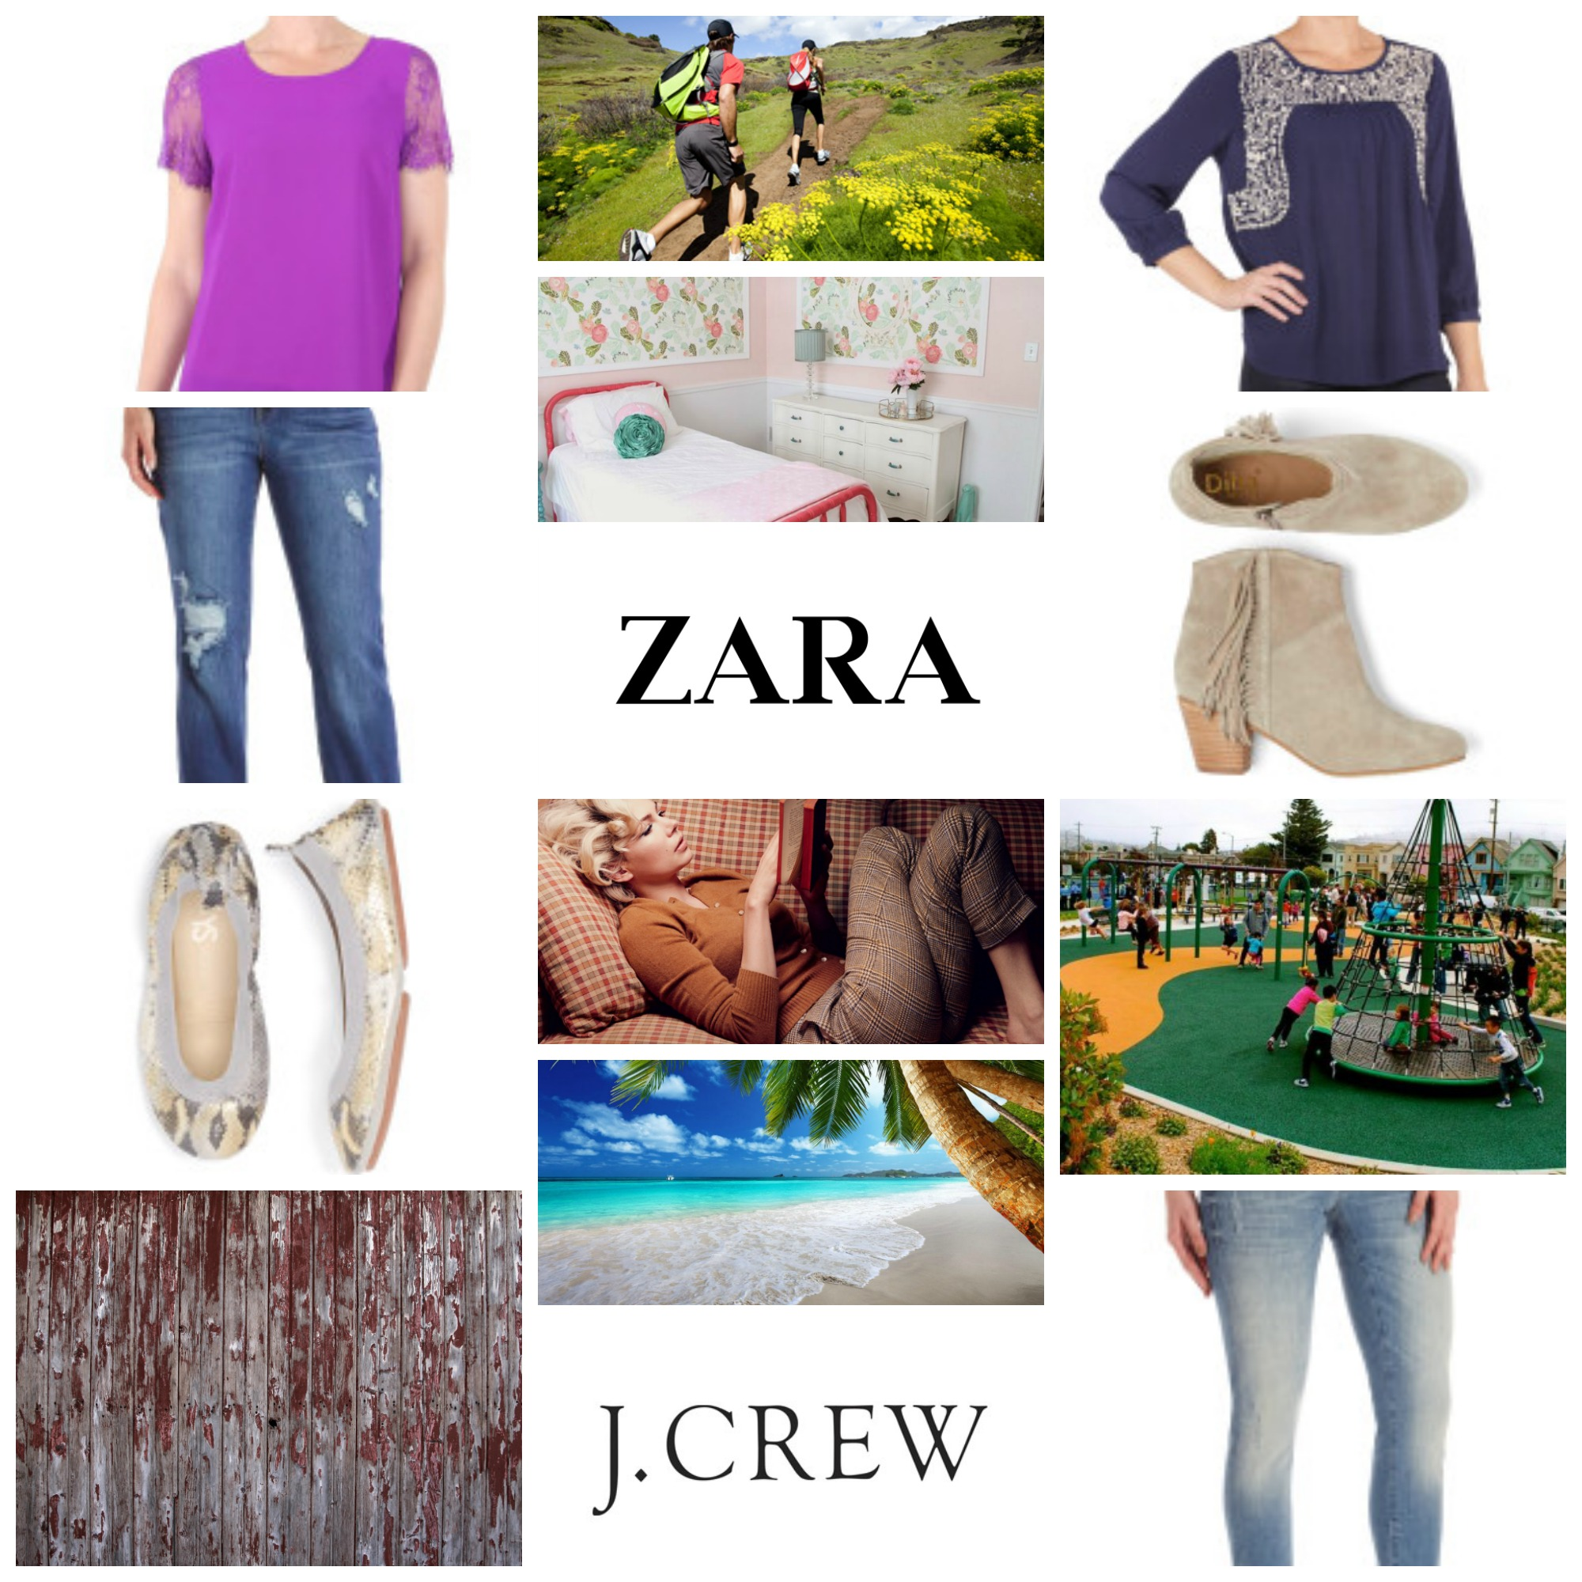
7. Internal Pinterest Page

Slide 16
Team 2
Windy Cumberbatch
Serena Chen
Natalie Wood
Jess Taylor
Laurie Hartt
Cheryl Walker
Kristen Alexander
Dana Stern
Raquel Shank
‹#›

Slide 17
Style Exercise Ideas- Ideas for updating the client profile on the backend (non client facing)
1- At checkout, based on the client’s purchases, the algorithm will suggest pieces for her next Fix. The client to say yes/no to the suggested options.
2- Allow the client to pin pictures from their Pinterest Board of things they would not wear-to give us a better understanding of their style.
3- At checkout, around every third Fix, add an option that would prompt the client to automatically update their style profile and/or Pinterest.

Slide 18
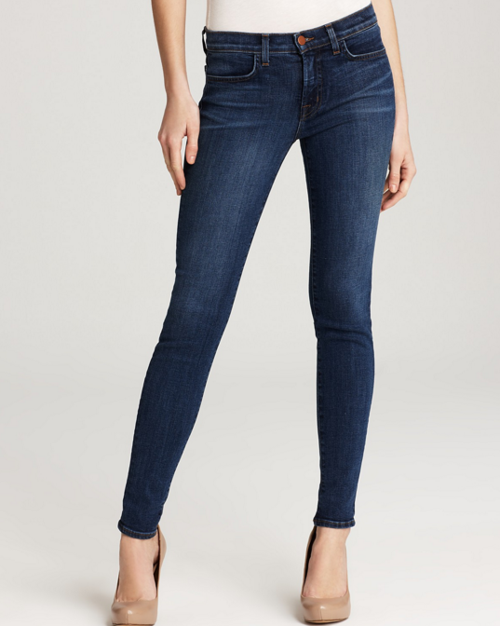
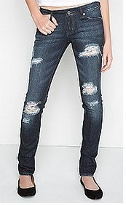
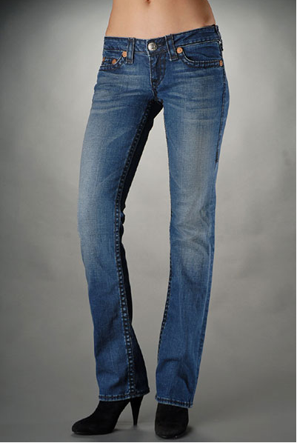
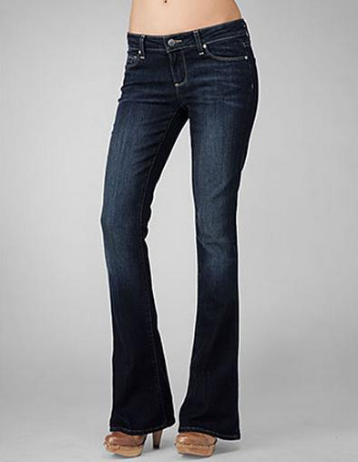
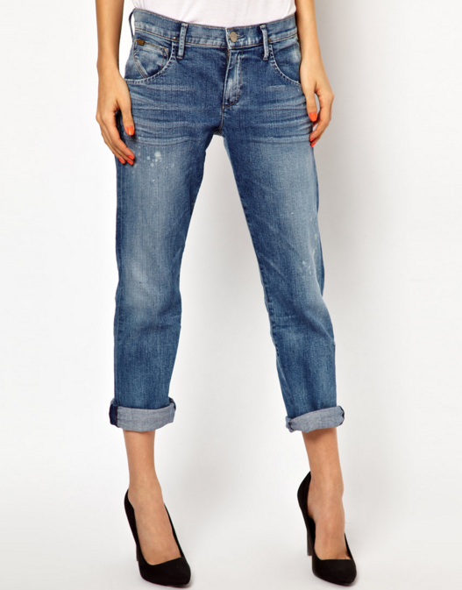
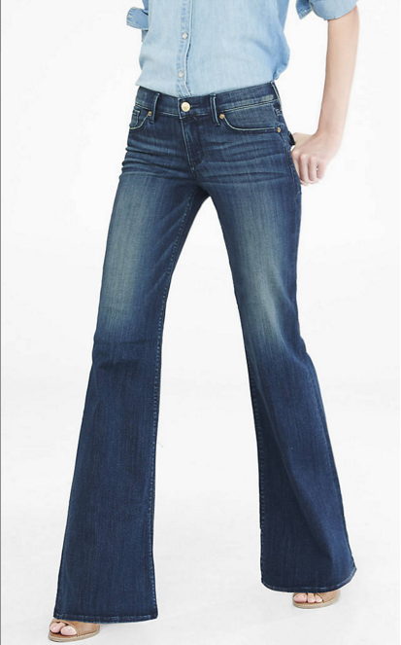
Denim Styles
Which of these denim styles are you most likely to wear: (Check all that apply)
Skinny
Distressed
Straight
Bootcut
Boyfriend
Flare

Slide 19
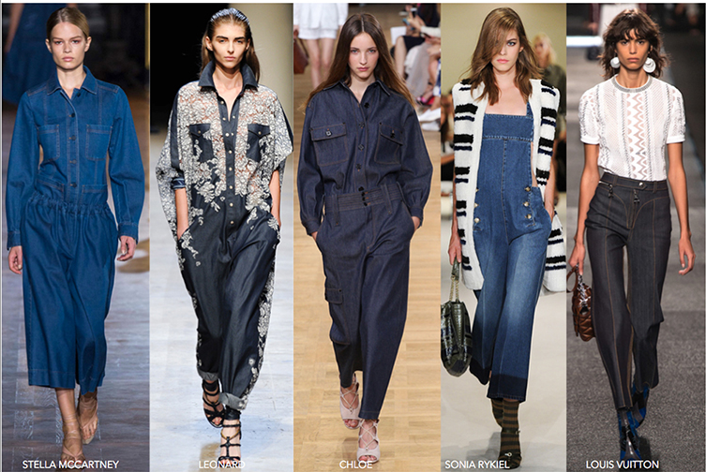
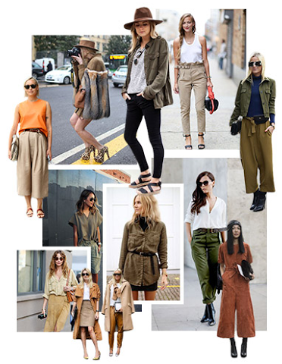
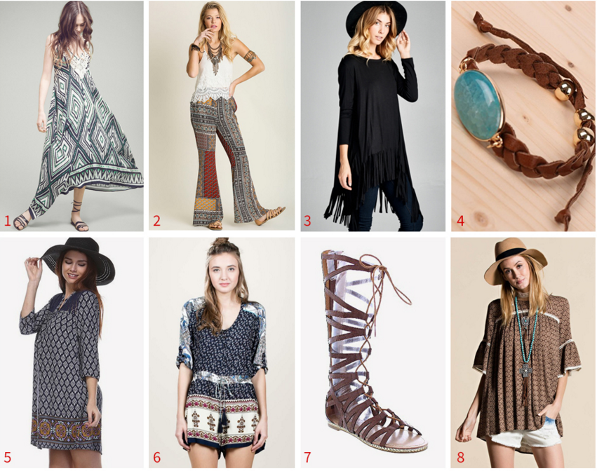
Seasonal Trends - Which of these trends are you most likely to wear? (To be updated seasonally)
Indigo
Boho Bliss
Desert Safari

Slide 20
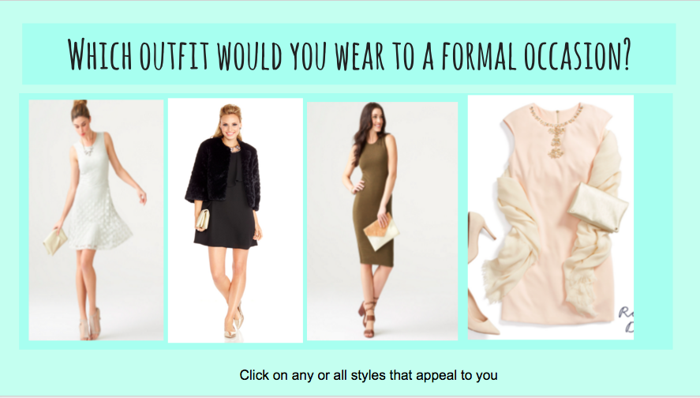
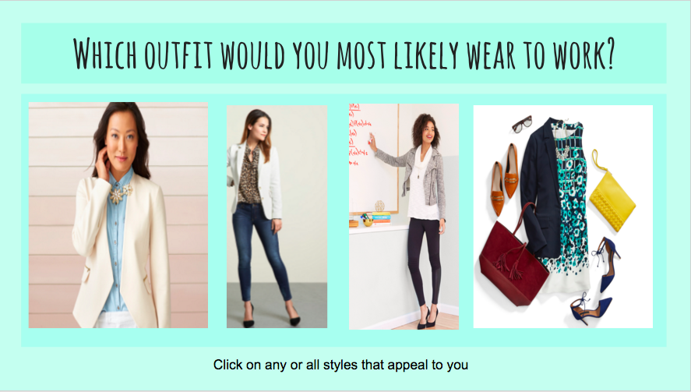
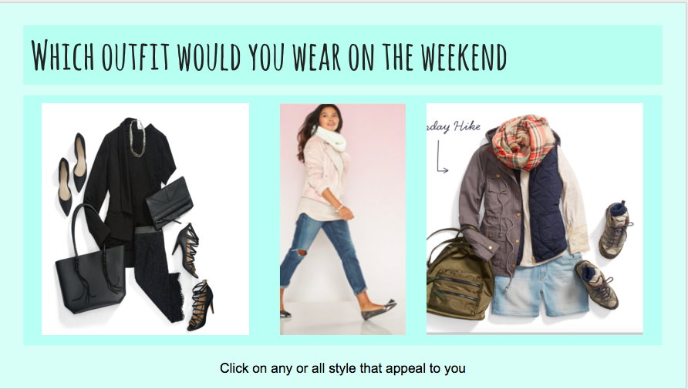

Lifestyle- To better understand your style, please tell us which you are mostly likely to wear. (Check all that apply)

Slide 21
Fit Preference
To better understand your fit preference, please indicate which option you’re most likely to wear in a blouse or top:
Tight 🔽
Fitted 🔽
Regular/Straight 🔽
Loose/Oversized 🔽
Tight, compressive fit
Body skimming fit, not compressive
Comfortable professional fit. Neither slim or oversized.
Generous, comfortable fit.
Notes:
Speak to adding in fit examples in the profile

Slide 22

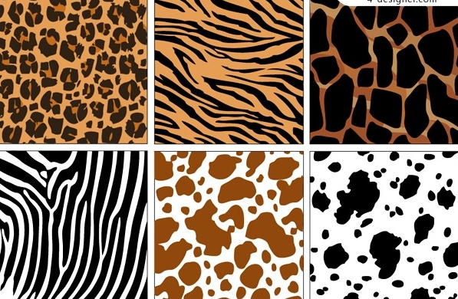
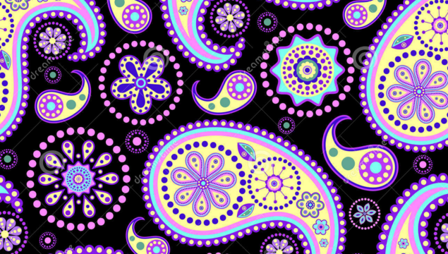
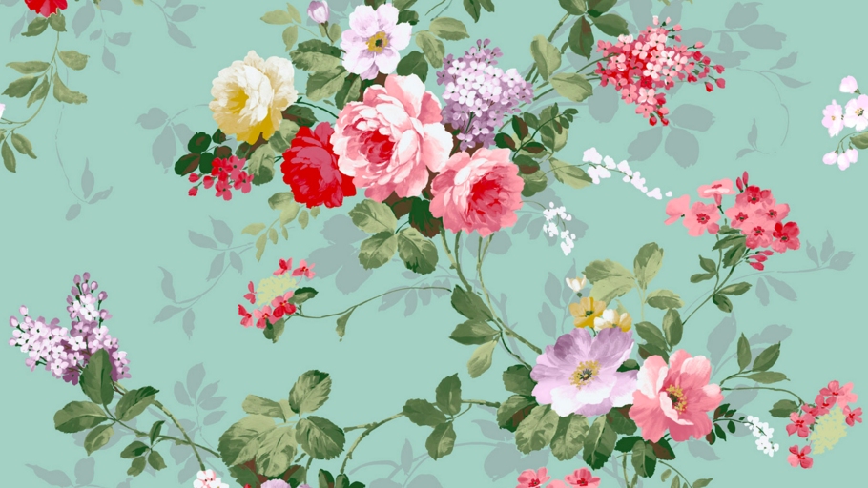

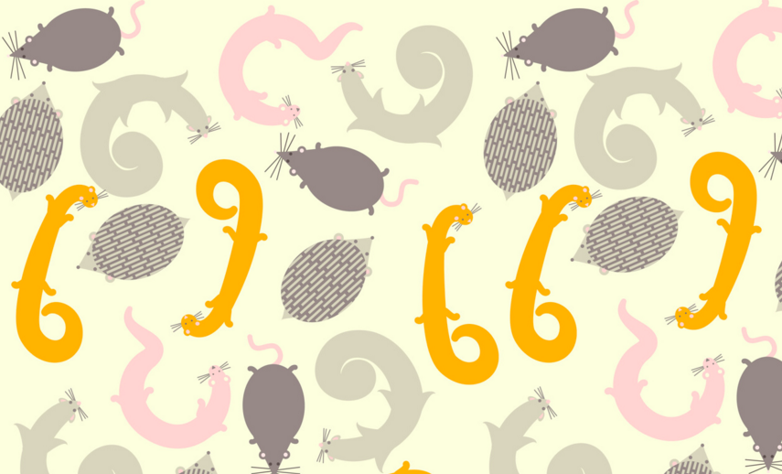
Pattern Play- What patterns are you most likely to wear? (Check all that apply)
Polka Dots
Animal
Paisley
Stripes
Floral
Critter

Slide 23
Team 3
Sarah Richardson
Ashley Roos
Jodi Inkenbrandt
Alyssa Ramirez
Alison Bendis
Tanya Scott
Heather Michaels
Alicia Vigil
Megan Wheeler
Kelly Reber
Michele Glassman
‹#›

Slide 24
Team 3
Style Exercise
Question:
How can we improve the Style Profile to get to know our Client’s style better?
Top Three Ideas:
An Internal Pin Board
Less Text, More Images
Text Questions Focused On Client’s Best Self

Slide 25
Examples

Slide 26
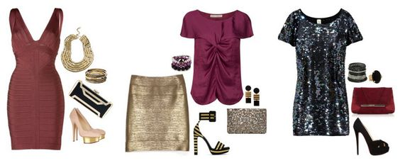
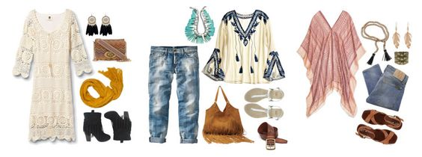
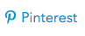
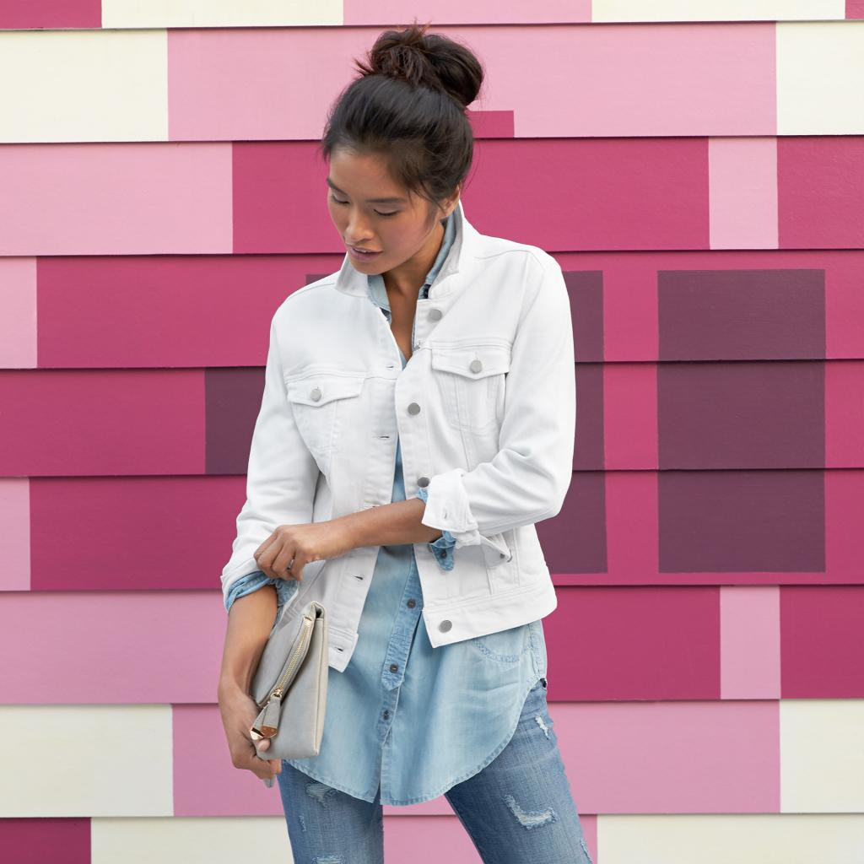
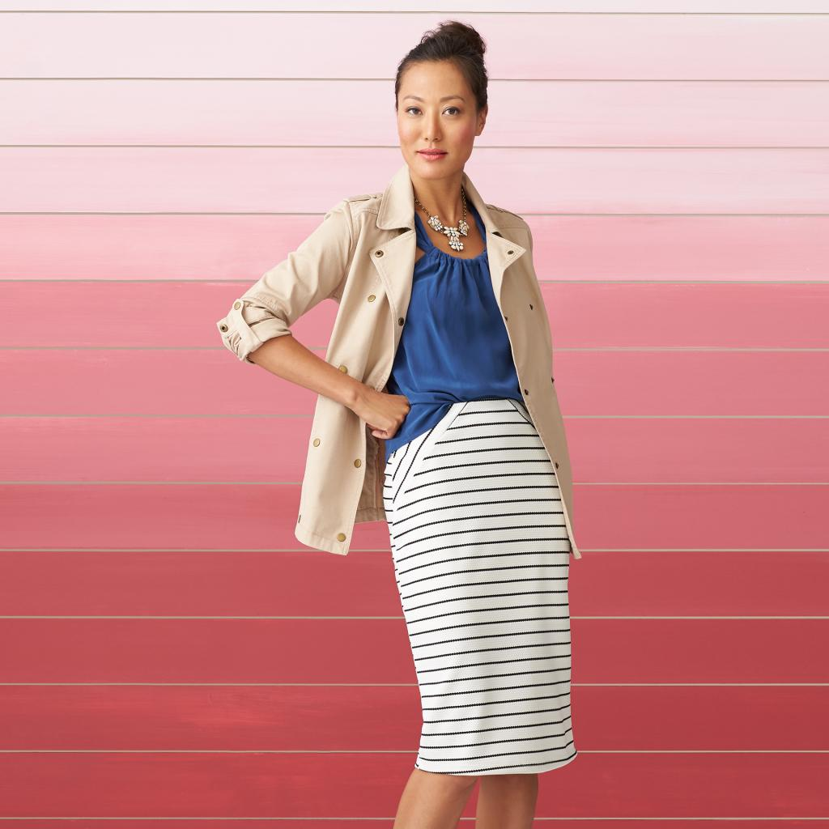
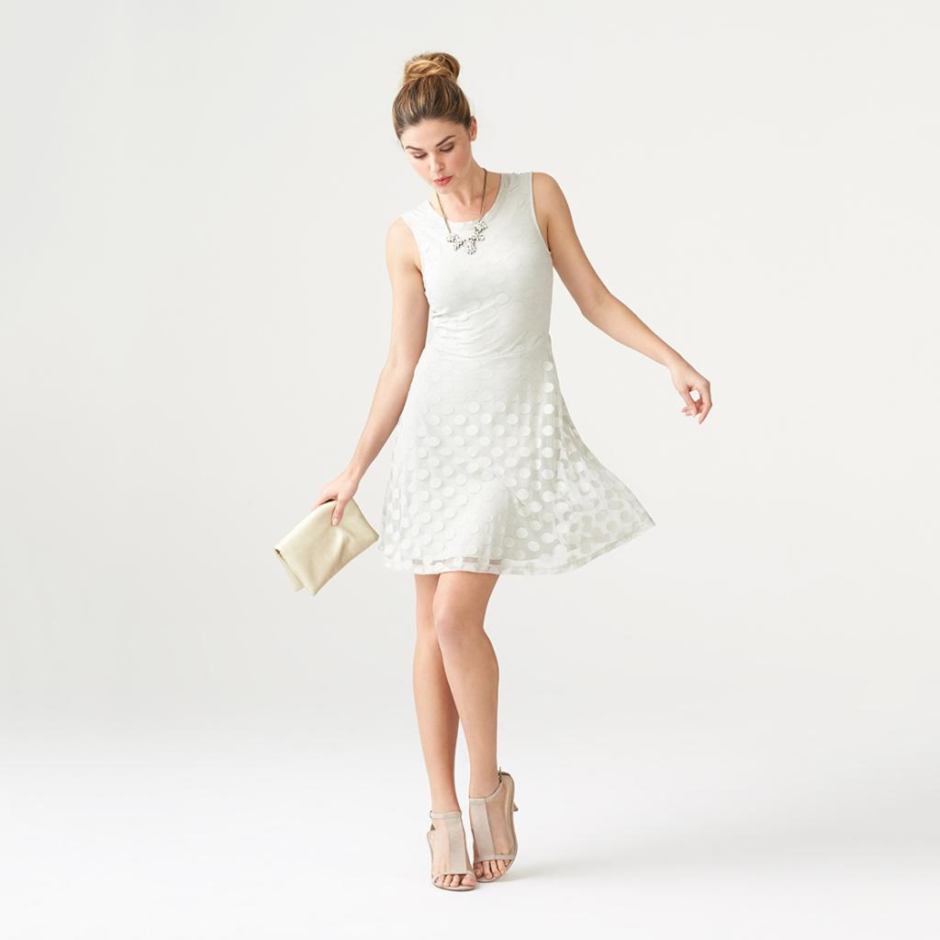
Internal Pin Board
Current:
Stylists only see a visual representation of the Client’s style if she includes a Pinterest board.
The “style photos” the Clients rank in the current profile are too extreme.
Our Idea:
A Client would build her own internal pin board using our merchandise/inspiration gallery.
Stylists would access this using a link/tab in Minx
Internal pin board could be separated by Occasion ie: casual, work, special occasion

Slide 27
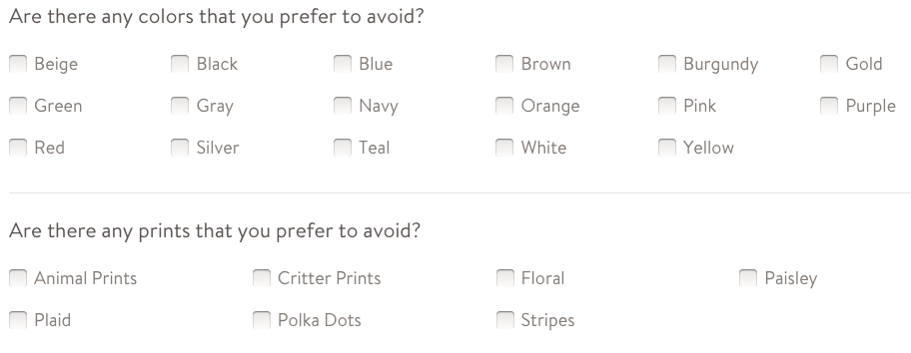
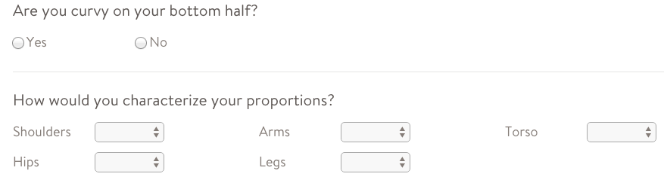
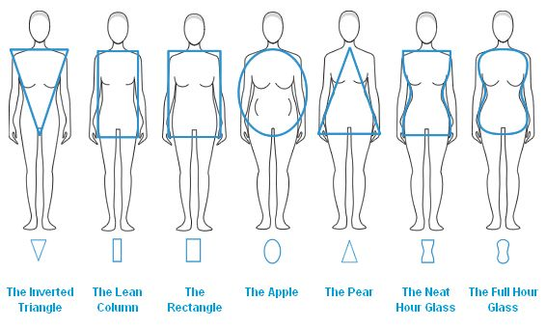

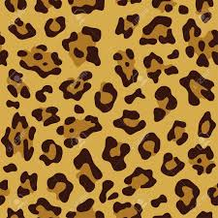
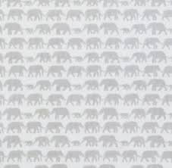
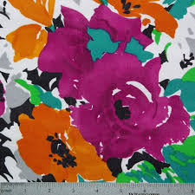




Less Text, More Images
Currently, Clients answer text questions:
Our Idea is to ask the client to select the following images:

Slide 28


Text Questions Focused On Client’s Best Self
Current:
Our Idea:
Tying these sections more closely to our idea of the client’s Best Self, while learning more about her.
I feel my best when I’m wearing… [free text response]
My best features are… [tick boxes, also include eyes, hair, etc]
I feel less comfortable showing off my… [tick boxes]
I feel most comfortable in these materials… [tick boxes]
I feel less comfortable in these materials… [tick boxes]

Slide 29
Team 4
Ashlee Duran
Caitlin Mell
Cody Warren
Edith Denning
Layla Katz
Lindsay Varney
Lindsey Beesley
Lori Eason
Lucy Chen
Meredith O'Brien
Mishelle Boutwell-Schmidt
Sally Wright
‹#›

Slide 30
Key Ideas
A/B Image Test
Internal Pinterest Board
Probing Lifestyle Questions
A different way to present style categories
“Tinder” for Style & Client Avatar

Slide 31




A/B Image Test
A/B Test in survey to have clients choose one of two looks like they like (either whole outfits or pieces of apparel from two different style categories)
Examples:
1.
2.
OR
OR

Slide 32

Internal Pinterest Board
Qualtrics-like test that would build an internal “Pinterest” board of pieces by apparel category that the client said she loves.
This would be linked to the profile stylists see in Minx. Our recommendation would be to use pieces from our inventory.

Slide 33
Probing Lifestyle Questions
Ask more probing questions about what the client’s lifestyle is:
Specific occupation information (text boxes)
Do you wear a uniform?
What does business casual mean to you?
Can you wear jeans to work?
Do you prefer to wear pants or dresses?
Are you on your feet all day?
What do you like to do on the weekends? (click boxes)
Brunch with friends
Going to the park
Hiking/biking
Shopping
Cooking
Ask more probing questions about what the client’s CURRENT & ASPIRATIONAL looks are so we can get an idea of her true comfort zone and style goals.
Add a series of questions on the Style Profile that clients would answer from drop-down options that would funnel down style preferences to specifics
Do you like this look?
If yes: Why?
Color? Details? Fit? Style?
Where would you wear this? Work, Weekend, Date NIght, Special Event, etc

Slide 34




A different way to present
style categories
Ask clients what the style categories mean to them through photos
ie - Show 4 pieces that are varying degrees of boho from small embroidery details to bold boho prints. Ask the client to rank styles from 4 to 1. (4 being the style they most identify with their boho preference, 1 being least.)

Slide 35

A different way to present
Style categories (continued)
Use imagery that is “user-generated” so people completing the style profile can see actual clients in our current inventory offerings in each category instead of the “mood board” style pieces that are currently on the style profile.
Inspiration: Our Ladies in Stitch Fix Pinterest Board!

Slide 36
“Tinder” for Style & Client Avatar
“Tinder”- style swipe left or swipe right functionality on mobile app or website that pops up daily as an opt-in push notification for clients to have the opportunity to update profile
The goal of this would be to motivate clients to update their profile and give new info to our stylists more frequently. The data would push info to the Minx profile for stylists to see and push info to algorithm
This functionality could show individual pieces, whole outfits, colors or patterns for client to vote yes/no to.
Think of it as a “question of the day”
Create an avatar that would reflect the proportions the client self identifies with so that the client could see how certains fits/styles fit on their bodies.

Slide 37
Team 5
Jamie Slye
Molly Dorman
Erin McFarlane
Jenni Bacich
Sam Salicce
Hannah Loyola
Kasey Proctor
Jackie Quinn
Alexandra O’Hearn
‹#›

Slide 38
Defining Personal Style
Your Go-To Outfit + Pops of Personality + Style #goals =
Your Personal Style

Slide 39


















Your Go-To Outfit
Clients choose from a “virtual closet” what they would wear on an average day. We would include mostly basics in the closet-- prints, patterns, colors, textures, and accessories will be defined next. We would provide options for casual, athleisure, work, and trend styles. Then she would caption it herself!
**Each style would be ranked according to a Style Point System behind the scenes and the building blocks of the outfit built by the client would give us a relative Style Score.
She also selects using radio buttons what key pieces she already has in her wardrobe and if she would like to receive more of.this style or not.
**These would be ranked as well to give us a relative Style Score, which would be averaged with her Daily Look Style Score.
To define your personal style, please help us learn more about YOU by telling us what you reach for in your closet every day!

Slide 40






Pops of Personality
Clients use radio buttons to select how often she wears or would wear the pictured silhouette, pattern, or statement piece to make her personality pop through her outfit.
What brings your daily outfits to life each day? Is it a pop of color? A favorite floral? An asymmetrical silhouette?

Slide 41

Style Goals
Lastly , clients use a free text box to tell us what they are looking for in the service so we can make sure we are delivering!
Tell us why you came to Stitch Fix for your personal style needs? What is in your dream Fix? What are some trends you want to rock one day? How can we help you achieve your style?

Slide 42
Team 6
Lana Conroy
Johanna Morgan
Catherine Tran
Michelle Dixon
Kate Baker
Lisa Fenton
Kau Vue
Patrice Mendoza
Heather Archuleta
Abby Smithey
Rebecca Launey
Jenny Almon
Rachel Anderson
Emily Brake
‹#›

Slide 43



Style Profile Images
Use Stitch Fix pieces only, and flat style the pieces
The images will align with our rainbow but the client’s will not be aware what category the images fall under in the rainbow.
Client’s will get a checkbox option for each outfit asking them what they liked about the outfit or what they did not like.
Providing a color board and pattern board for clients to choose likes and dislikes.
Evolve images and questions as trends or seasons change
At the end of the survey we will ask clients to describe their style now.

Slide 44







Inspiration Board

Slide 45

The Evolution of the Rainbow

Slide 46
Team 7
Katie Dare
Tracy Wilson
Amanda Bergen
Rachel St. Moritz
Rebecca Sharbono
Kara Schurtz
Alicia Barker
Megan O’Donnell
Elizabeth DiFiore
Amanda Throldahl
Darla Abrego
‹#›

Slide 47

Mission
Idea
Taking our clients back to the basics when it comes to style questions!
92% of clients don’t know their style, we’re here to help them define it!
Ask Client General Questions
Show visual pictures to engage client
Create a visual mood board for the client
Notes:
*the client will “create” this mood board without knowing that they are
*With giving visual examples of Colors, Patterns, Texture, and Details we will create a Mood Board for the client to better see and understand her likes/dislikes and overall look that she’s going for. This will help us better define her style (like an inhouse pinterest board?)
definition of mood board: *Graphic designers, interior designers, industrial designers, photographers and other creative artists use mood boards to visually illustrate the style they wish to pursue.

Slide 48
Starter Questions
Why did you join? Convenience - i’m busy!/ to find my style / for the adventure
What are your Style Goals? Re-build my wardrobe - basics included! / enhance my current wardrobe - i want those adventurous pieces! / a healthy mix of both / other ________
Who’s your Celebrity Style Crush? ______(freeform)
Where do you shop and why? ______(freeform)
What’s the day in the life of you look like? ______(freeform)
What words best describe you? ______(freeform) / ______(freeform) / ______(freeform)
What’s your biggest challenge when it comes to Getting Dressed? ______(freeform)
What’s your go-to piece? ______(freeform)

Slide 49


What Colors Are You Loving ?
Is there anything else we should know?
White
Beige
Brown
Black
Gray
Silver
Red
Orange
Pink
Purple
Green
Teal
Blue
Navy
Yellow
Gold
Notes:
Here is just a rough idea of the colors we could display

Slide 50














What Patterns Are You Loving?
(Please look at print not color)
Is there anything else we should know?
Floral
Paisley
Critter
Animal
Plaid
Stripes
Polka Dots
Notes:
The client would go through a series of pictures revolved around prints to get a true understanding of what she’s loving/not loving.

Slide 51








What textures/fabric Details Are You Loving?
Is there anything else we should know?
Fringe
Lace
Ruffles
Crochet
Metal
Leather/ Pleather
Sequins
Elbow Patches

Slide 52
Example: Sally Sue
Starter Questions
Why did you join? to find my style
What are your Style Goals? enhance my current wardrobe - i want those adventurous pieces!
Who’s your Style Crush?
Gwyneth Paltrow, a working mom but still put together
Where do you shop?
Ann Taylor, Express
What’s the day in the life of you look like?
Wake up and send the kids off to school, Head to my marketing job in the city, run the kids around to practices all night, and hopefully see my husband before we both pass out.
What words best describe you?
Mom, modest, classic
What’s your biggest challenge when it comes to GETTING DRESSED?
Finding pieces to make me feel confident.
What’s your go-to piece? A cardigan and striped shirt

Slide 53
White
Beige
Black
Gray
Silver
Red
Green
Teal
Is there anything else: Love neutrals, look good in salmon not reds, am a redhead so I love green and pops of blue to match my eyes
Polka Dots
Critter
Stripes
Animal
Is there anything else: Enjoy some prints but my closet is basically full of stripes. Found the critter look interesting and love a great cheetah print!
Leather/ Pleather
Elbow Patches
Metal
Is there anything else: Enjoy genuine leather not pleather, elbow patches are a fun accent and so is studs/shiny metals! Love a little bling!

Slide 54



mom
adventurous
classic
Sally
modest
marketing
express
ann taylor
Gwyneth Paltrow

Slide 55
Did we CAPTURE your mood?

Slide 56
Team 8
Jana Carter
Jenn Johasky
Molly Roach
Molly Hazel
Joannie McIntyre
Camila Matos
Rachelle Gee
Staci Morris
Sarah McCary
Erika Spratt
‹#›

Slide 57
STYLE PROFILE GOALS:
To create the perfect balance between art and science. Helping the algorithm better calculate match scores while providing Stylists with smart tools to better curate amazing Fixes to surprise and delight her.
We’ll achieve this through:
Asking targeted questions
Providing clients with more visually appealing imagery to reference while completing their profile
Providing stylists with better tools to reference and understand her
Provide clients with a Flip book approach to identifying styles that would help her look and feel like her best self
Collecting additional data at checkout that captured her preference about upcoming trends

Slide 58
REFRESH STYLE PROFILE QUESTIONS
How do you spend your day?
I work from home
Keeping up with my kiddos
In an office
Student
Other (if selected, provide a text box to specify)
Based off of her answer, we would formulate the next question. i.e. If she picks “In an office”
What do you do for work? (free form text box)
My office attire is
Professional - Jackets necessary
Business Casual
Business Casual - jeans are okay some days
Casual - Anything goes
If she selected “Keeping up with my kiddos” the track of questions would be different. By tailoring the questions to how each client spends her day, we’ll be better equipped to style her.
Instead of the Profile Notes Field, we would like to rename that to say Bio and provide an example of what she should tell us (i.e. How would you describe your style? What do you do on weekends? Who is your favorite style icon? Do you prefer timeless, trendy, or a healthy blend of both?)

Slide 59

WHERE DO YOU LIKE TO SHOP?
She would be able to quickly and easily select which brands she most closely identifies with and places she enjoys shopping. We would also add the option for her to type in any other brands she loves.

Slide 60

WHICH OF THE FOLLOWING TEXTURES WOULD YOU LIKE TO SEE IN YOUR FIX?
Sequins
Crochet
Fur
Faux Fur
Leather
Lace
Giving clients a visual representation of textures will help them quickly identify their likes/dislikes? (we would likely include more options for clients to select)
AFFIRMATION STATEMENTS - Okay Got it! We’ll avoid sending you Faux Fur, Sequins and Leather

Slide 61

HOW ABOUT PATTERNS - WHICH ONES SHOULD WE INCLUDE?
Critter Prints
Polka Dots
Geo Prints
Floral
Leopard
Stripes

Slide 62

TELL US ABOUT YOUR DENIM PREFERENCES!
Wide Leg
Flare
Boyfriend
Distressed
Skinny
Straight Leg
Bootcut
Culottes
Notes:
Should we have pop - puts so that people can read about the difference between fits?

Slide 63




THE FLIP BOOK
To better determine which items a client most closely identifies with, we’d like to create a flipbook similar to a visit to the eye doctor - where a stylist will use thumbs up or thumbs down to signify if an item is something she would like to see in her wardrobe.
Items she identifies with a thumbs up would then be displayed on her mood board
Items pictured would be displayed as a singular item in a laydown
With each selection, the survey will present another pair of items for the client to tell us if she likes or dislikes.
Notes:
Slide is/will be animated so when you click on the thumbs up/down new options are presented :-)

Slide 64


THE FLIP BOOK

Slide 65


THE FLIP BOOK
As clients finalize their likes/dislikes in each category. Head-to-toe looks on a model will be presented for her to confirm that we’ve matched her style.
These head-to-toe looks will also be present on her

Slide 66

PROFILE UPDATES - CONTINUED
The rainbow of styles would still be used by the algorithm in the background but would not be available for stylists to see.
Stylists would make decisions, based on match scores, her mood board, pinterest board, client body measurements/attributes and her bio.
On a quarterly cadence, provide her with more convenient ways to update her profile vs. logging in
Email her with a snapshot of her current profile and allow her to update it at checkout or when she’s adding a request for her current Fix.
Based off of her likes/dislikes throughout her profile a Mood Board will be created for each client.
This would be updated quarterly to ensure newness and seasonal appropriateness

Slide 67











CLIENT NAME HERE
Notes:
MOOD BOARD - this would represent patterns/textures/items client liked during the flipboard. This board would be much larger and contain both lifestyle imagery and product laydowns.

Slide 68



What do you think of these looks for Spring?

Slide 69
Team 9
Lindsay McLaughlin
Jackie Guilbault
Jillian Turri
Lindsay Olivarez
Sarah Wilson
Tiffany Aschenbrenner
Brittney Wood
Nicole Ng
Karin Dupay
Katie Wallin
Bernadette Thorne
Heather Picou
‹#›

Slide 70
What are we looking to accomplish?
How can we make this process more personal?
Learn more about her lifestyle
What activities does she spend most time doing?
What is she looking to get out of Stitch Fix? (statement/basics)
How do we capture more information without making her feel like everyone else?
Show her more images
Let her tell us what she wants
Find out what her go to’s are
Check in with her
Asking follow up questions throughout her experience with us
What is she looking to add to her closet
Have her needs changed?
Notes:
Ideas for our Slide:
Add questions to profile:
Where do you shop?
Where do you aspire to shop?
Get more specifics around their occupation
How casual is your work attire
Can/Do you wear jeans to work
How often do you wear jeans at work
More specific around maternity
Ask if they would like to update the frequency of their Fixes
Ask if they would like to receive nursing friendly tops/dresses
Why are you trying Stitch Fix (to gauge adventurousness)
Install a completion bar or % complete that updates each page or after each question.
Better understand her style:
Make the style collages "live". Each item or look would be clickable.
She clicks on each item she is most likely to wear.
Each of those items is added to her personal style board. (polyvore style)
Better understand her fit intent:
show silhouettes that describe our tight, fitted, loose, etc and ask her to choose what she's most likely to wear
Do the same for dresses and bottoms
Allow her to rank each
Other items we came up with:
show photos of our clothes on body
photos/models would change based on her height & size
Ask- are there colors or styles you would never wear?
Who is your fashion icon?
What wardrobe staples do you own
What is your favorite piece of clothing
What frustrates you about your current wardrobe
What is your ideal casual outfit
Add live support into the profile
Make certain questions mandatory
Make the Avoids/Flaunts section clearer
Add in photos of patterns- i.e. critter, border, conversational, animal
Ask her 3 words that define her style
Show a series of Fixes and ask which ones she is most likely to keep
Ask what body type she thinks she is
Create an algorithm that can calculate her body type based on her profile info (like Body Visualiser)
Add photos and visuals all the way through to make it less text heavy
Add visuals for inseam/neckline/silhouette
Add glossary of style terms
Ideas around Check Out Survey:
Ask more follow up questions:
ask more pointed questions on fit
ask about colors, prints
have an option- I came to you to be more fashion forward
Add a sliding scale rather than love it, like it, hate it.
Take hate out of it so that we can get more constructive information
Add a checkout option:
I'd like to try the same stylist again
I'd like to try a new stylist next time

Slide 71



What would the New Profile Look Like?
Occupation would be a freeform box

Slide 72



Questions focused on finding out more about her

Slide 73

Based on her answer to frequent activities we would show outfit options....
We would show her a variety of outfits for every activity she clicked on
Outfits would be a variety of styles
Outfits would be comprised of variety of colors

Slide 74

We would ask her what she loves to wear and what she never wears
Similar to the men’s sign up we would ask for styles they would or would not wear. This can change throughout seasons or just reflect basic core styles.

Slide 75
Checking Back In
What brands have you been enjoying?
What do you love adding to your closet?
What key styles are you missing from your closet?
Push notifications prompting her to easily change her Style Profile as time goes on.
Swipe left/right!
Seasonal questions (“Are you looking for a coat?” // “We’re loving these five trends for spring. Which is your favorite?” // “It’s almost wedding season! Do you have an event coming up?”)
These notifications could automatically add to her Request Note (e.g. “Loving 70s boho!”) or open a pop-up of her Request Note so she can type.

Slide 76
Team 10
Audrey Vanecek
Meg Eversfield
Lauren Nelson
Kristy Pritzl
Lauren Miguez
Eleanor Honeyman
Brooke Breon
Lindsey Hernandez
Julie Brinker
Amanda Torres
Cloey Del Santo
‹#›

Slide 77
Team 10’s Ideas
Add questions that help us to better understand her
Shopping and motivation
Clarify occupation and work attire
More questions around maternity
Make the profile more interactive and use more images
Create a personalized style board for each client
Clarify her Fit Intent
Create a personalized fit preference board for each client
Let her know how she’s doing
Add a completion bar to the top of each page of the profile
Notes:
Ideas for our Slide:
Add questions to profile:
Where do you shop?
Where do you aspire to shop?
Get more specifics around their occupation
How casual is your work attire
Can/Do you wear jeans to work
How often do you wear jeans at work
More specific around maternity
Ask if they would like to update the frequency of their Fixes
Ask if they would like to receive nursing friendly tops/dresses
Why are you trying Stitch Fix (to gauge adventurousness)
Install a completion bar or % complete that updates each page or after each question.
Better understand her style:
Make the style collages "live". Each item or look would be clickable.
She clicks on each item she is most likely to wear.
Each of those items is added to her personal style board. (polyvore style)
Better understand her fit intent:
show silhouettes that describe our tight, fitted, loose, etc and ask her to choose what she's most likely to wear
Do the same for dresses and bottoms
Allow her to rank each
Other items we came up with:
show photos of our clothes on body
photos/models would change based on her height & size
Ask- are there colors or styles you would never wear?
Who is your fashion icon?
What wardrobe staples do you own
What is your favorite piece of clothing
What frustrates you about your current wardrobe
What is your ideal casual outfit
Add live support into the profile
Make certain questions mandatory
Make the Avoids/Flaunts section clearer
Add in photos of patterns- i.e. critter, border, conversational, animal
Ask her 3 words that define her style
Show a series of Fixes and ask which ones she is most likely to keep
Ask what body type she thinks she is
Create an algorithm that can calculate her body type based on her profile info (like Body Visualiser)
Add photos and visuals all the way through to make it less text heavy
Add visuals for inseam/neckline/silhouette
Add glossary of style terms
Ideas around Check Out Survey:
Ask more follow up questions:
ask more pointed questions on fit
ask about colors, prints
have an option- I came to you to be more fashion forward
Add a sliding scale rather than love it, like it, hate it.
Take hate out of it so that we can get more constructive information
Add a checkout option:
I'd like to try the same stylist again
I'd like to try a new stylist next time

Slide 78




Clarifying Questions To be Added
Where do you currently shop?
Where do you aspire to shop?
Why are you using Stitch Fix?
To get pushed out of my comfort zone
How often would you like to receive Fixes?
Field of work?
Would you like to receive nursing friendly items?
Management
How casual or dressy is your workplace?
How casual or dressy is your workplace?
Can/do you wear jeans to work?
Notes:
Add questions to profile:
Where do you shop?
Where do you aspire to shop?
Get more specifics around their occupation
How casual is your work attire
Can/Do you wear jeans to work
How often do you wear jeans at work
Why are you trying Stitch Fix (to gauge adventurousness)
Install a completion bar or % complete that updates each page or after each question.

Slide 79




Better Understand Her Style
Please click on the items that you would like to see in your closet:
Notes:
Most clients identify with more than one style category.
We would use SF items that fit into each category.
We believe that they should still be a laydown style collage.
Collage will be live- clickable
We will ask her which hypothetical pieces she would most like to have in her closet.

Slide 80







Better Understand Her Style
Click to add the colors you are most likely to wear:
Click to add the patterns you are most likely to wear:
Geo Prints
Animal Prints
Plaids
Critter Prints
Stripes
Florals

Slide 81
Her Personalized Style Board
Notes:
Does This best represent the style you’re going for?
Tell us if you are looking for anything in particular. Is there anything more you would like to tell us about your personal style?

Slide 82




Better Understand Her Fit Preferences
LOOSE

Slide 83
Her Personalized Fit Preferences Board
Notes:
Does this best represent how you like your clothes to fit?

Slide 84

Completion Bar
60% Complete!

